Slide 1

Digital Portfolio
Jayaram R
September 24, 20XX
Customer Success Team

Slide 2
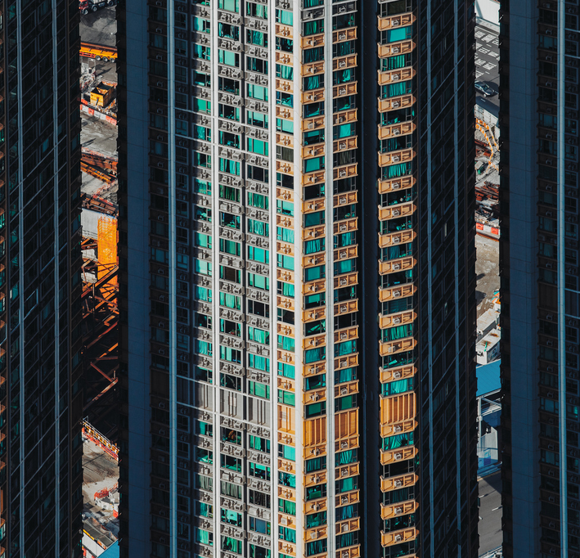
Agenda
Introduction
Project over view
Technologies tools
Port folio design and layout
Results and screen shots
Conclusion

Slide 3

Introduction
I’m a passionate Web Developer focused on building responsive, user-friendly, and modern websites.
With a strong foundation in HTML, CSS, JavaScript, and
Frameworks like React, I specialize in turning ideas into functional, elegant digital experiences.

Slide 4
Project Overview
Overview: This is a personal portfolio website I built from scratch using only HTML and CSS. The goal of the project was to create a clean, professional, and fully responsive website that showcases my web development skills and provides a space to present my background, skills, and contact details.
Key Features:
Fully hand-coded using HTML and CSS
Responsive layout for mobile and desktop
Sections: Home, About, Projects,
Simple and elegant design
Development Process:
Structured the content using semantic HTML
Styled the website using custom CSS
Tested responsiveness on multiple devices
Outcome: A lightweight, fast-loading portfolio website that reflects my identity as a web developer and serves as a digital resume.

Slide 5
Technology Tools
HTML – For structuring the content of the website using semantic elements like <header>, <nav>, <section>, <footer>, etc.
CSS – For styling the website including layout, fonts, colors, spacing, and responsive design using media queries.
Tools Used:
VS Code – As the code editor to write and organize my HTML and CSS files.
Google Chrome – For testing the website and inspecting elements using Developer Tools.
Git & GitHub – For version control and (if used) hosting the portfolio online.
Figma / Pen & Paper – For sketching or wireframing the layout design before development.

Slide 6
Port folio design and layout
Layout Structure:
Header: Contains name/logo and navigation links (Home, About, Projects, Contact)
Hero Section: Introduction with a headline, short description, and a CTA (e.g., “View My Work”)
About Section: A brief intro about yourself, skills, and experience
Projects Section: Showcasing sample works or real projects with brief descriptions
Design Approach:
Color Scheme: Blue and Green (or your chosen colors)
Font Style: Clean, modern sans-serif .
Layout Type: Single-page scroll layout
Responsiveness: Fully responsive using CSS Flexbox & Media Queries

Slide 7
Conclusion
Conclusion
Creating this personal portfolio website helped me apply and enhance my HTML and CSS skills in a real-world scenario.
Through this project, I learned the importance of:
Clean code structure
Responsive design
User-friendly layouts
Visual consistency
This portfolio now serves as my digital identity and a platform to showcase my work to potential clients, employers, or collaborators.
I look forward to improving and expanding it with new features and projects in the future.

Slide 8
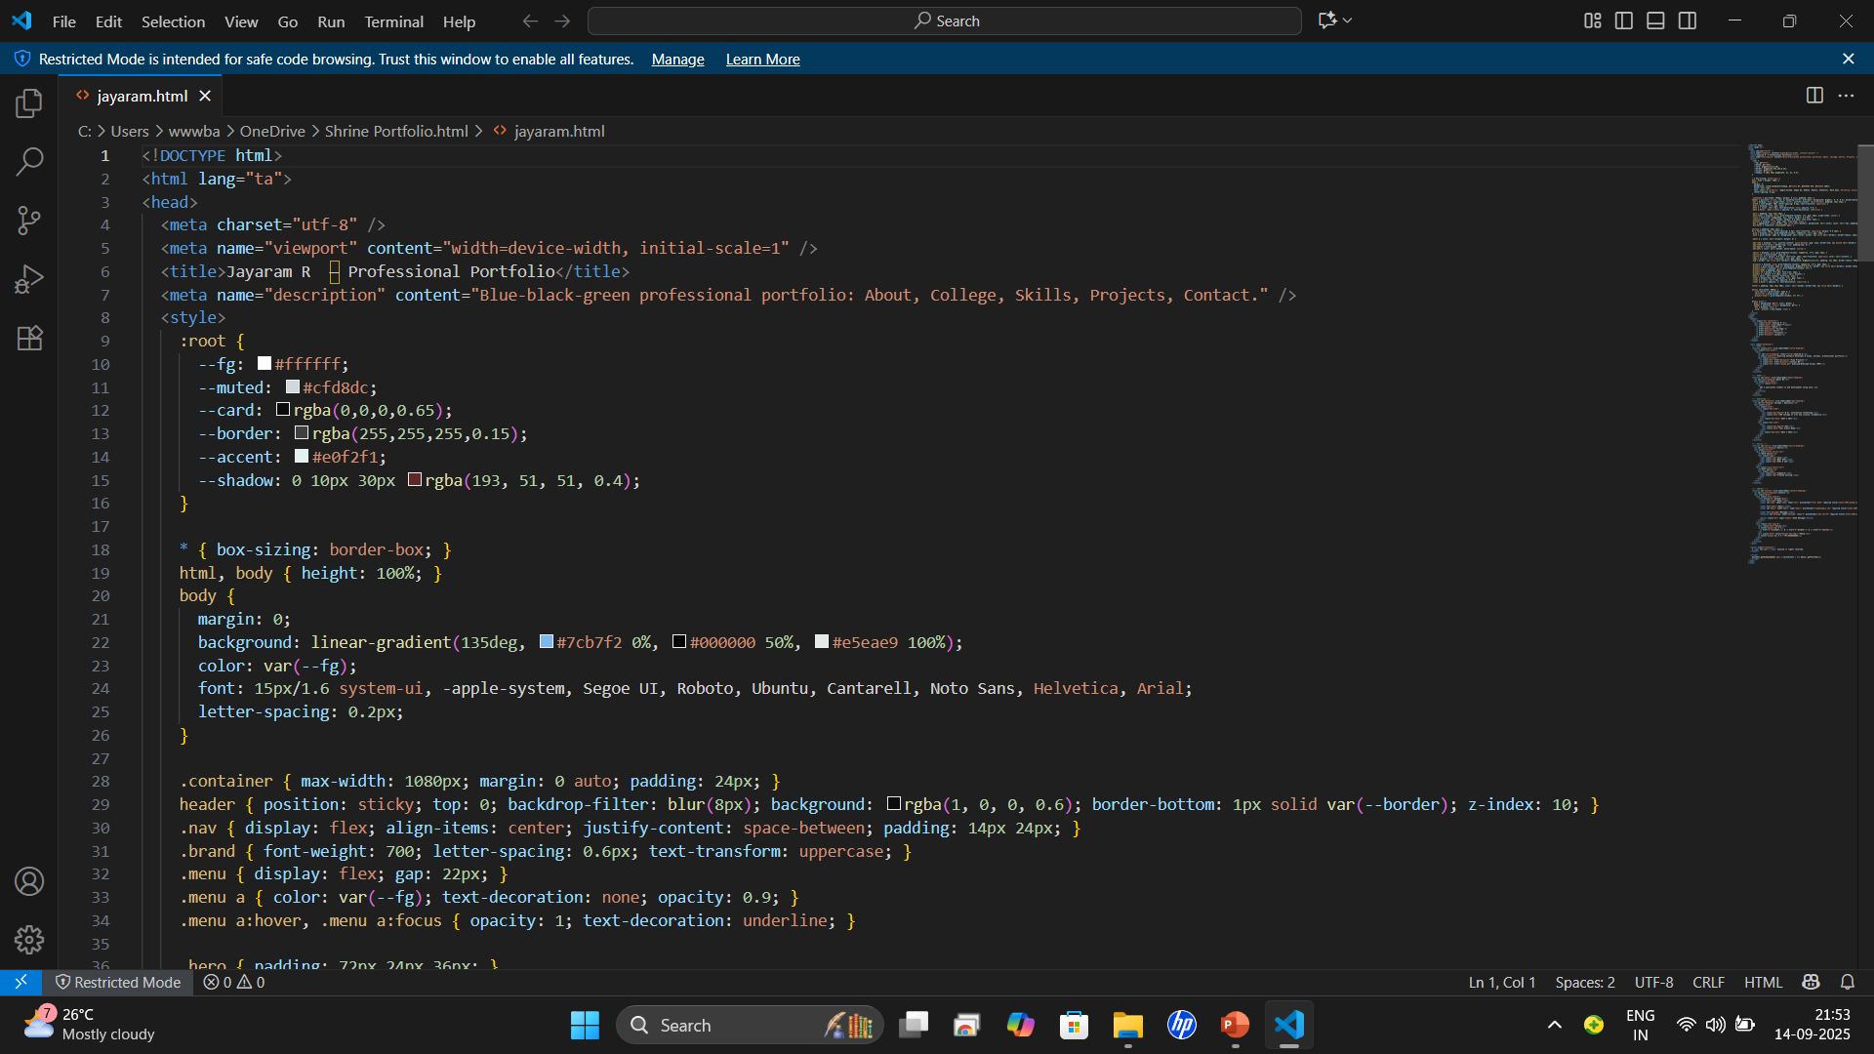
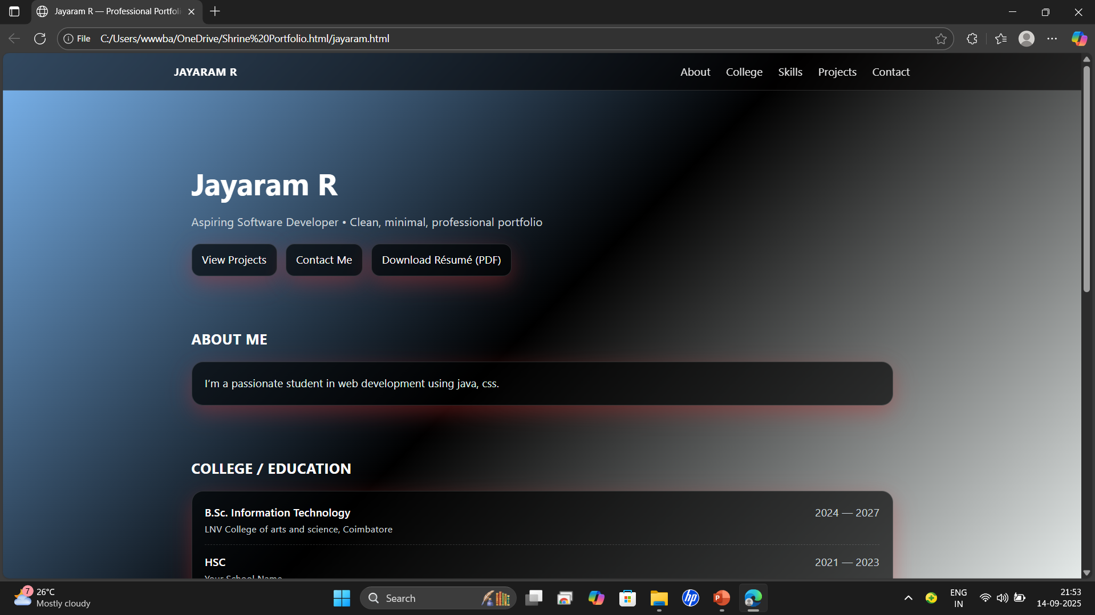
Results and Screenshots
Screenshot
Result

Slide 9

Thank YOU
Jayaram R

